Slide 1
Table Tennis Juggling using HER & DDPG
Yu Chen
Yuan Zhang

Slide 2

Table Tennis Juggling
Minimal Viable Product (MVP)
Simple environment
Implement the same strategy as paper (ball released, bounce, and paddle try to catch it for 1 time)
Endless Juggling
Continue to bounce and catch the ball after catching it
Complex Environment
MVP -> Endless Juggling -> Complex Environment

Slide 3
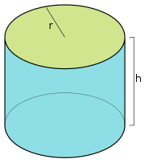
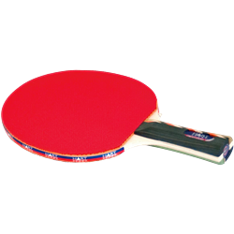
Environment
Setting
MuJoCo
Ball and paddle trajectory: 2D/3D
Bounce: same velocity in opposite direction/friction and elasticity concerned
Bound paddle and ball in a rectangular/cylinder
Reward
Sparse rewards
Earn reward when catch the ball and keep the ball in range
Observation
Can only observe paddle
Can’t observe ball unless it is out of range
MVP
Complex Environment

Slide 4
Agent (Paddle)
Action
Discrete/Continuous action space
DOF: 1 rotation + 2 transition/2 rotation + 3 transition
State
Paddle position (DOF: 2/3)
Paddle angle (DOF: 1/2)
State-goal distributions
Ball released at a random position for each episode
Paddle bounce the ball at a random state for each episode
So the goal for each episode is different
MVP
Complex Environment

Slide 5
Reference Paper
Andrychowicz, M., Wolski, F., Ray, A., Schneider, J., Fong, R., Welinder, P., ... & Zaremba, W. (2017). Hindsight experience replay. In Advances in Neural Information Processing Systems(pp. 5048-5058).
Lillicrap, T. P., Hunt, J. J., Pritzel, A., Heess, N., Erez, T., Tassa, Y., ... & Wierstra, D. (2015). Continuous control with deep reinforcement learning. arXiv preprint arXiv:1509.02971.

Slide 6
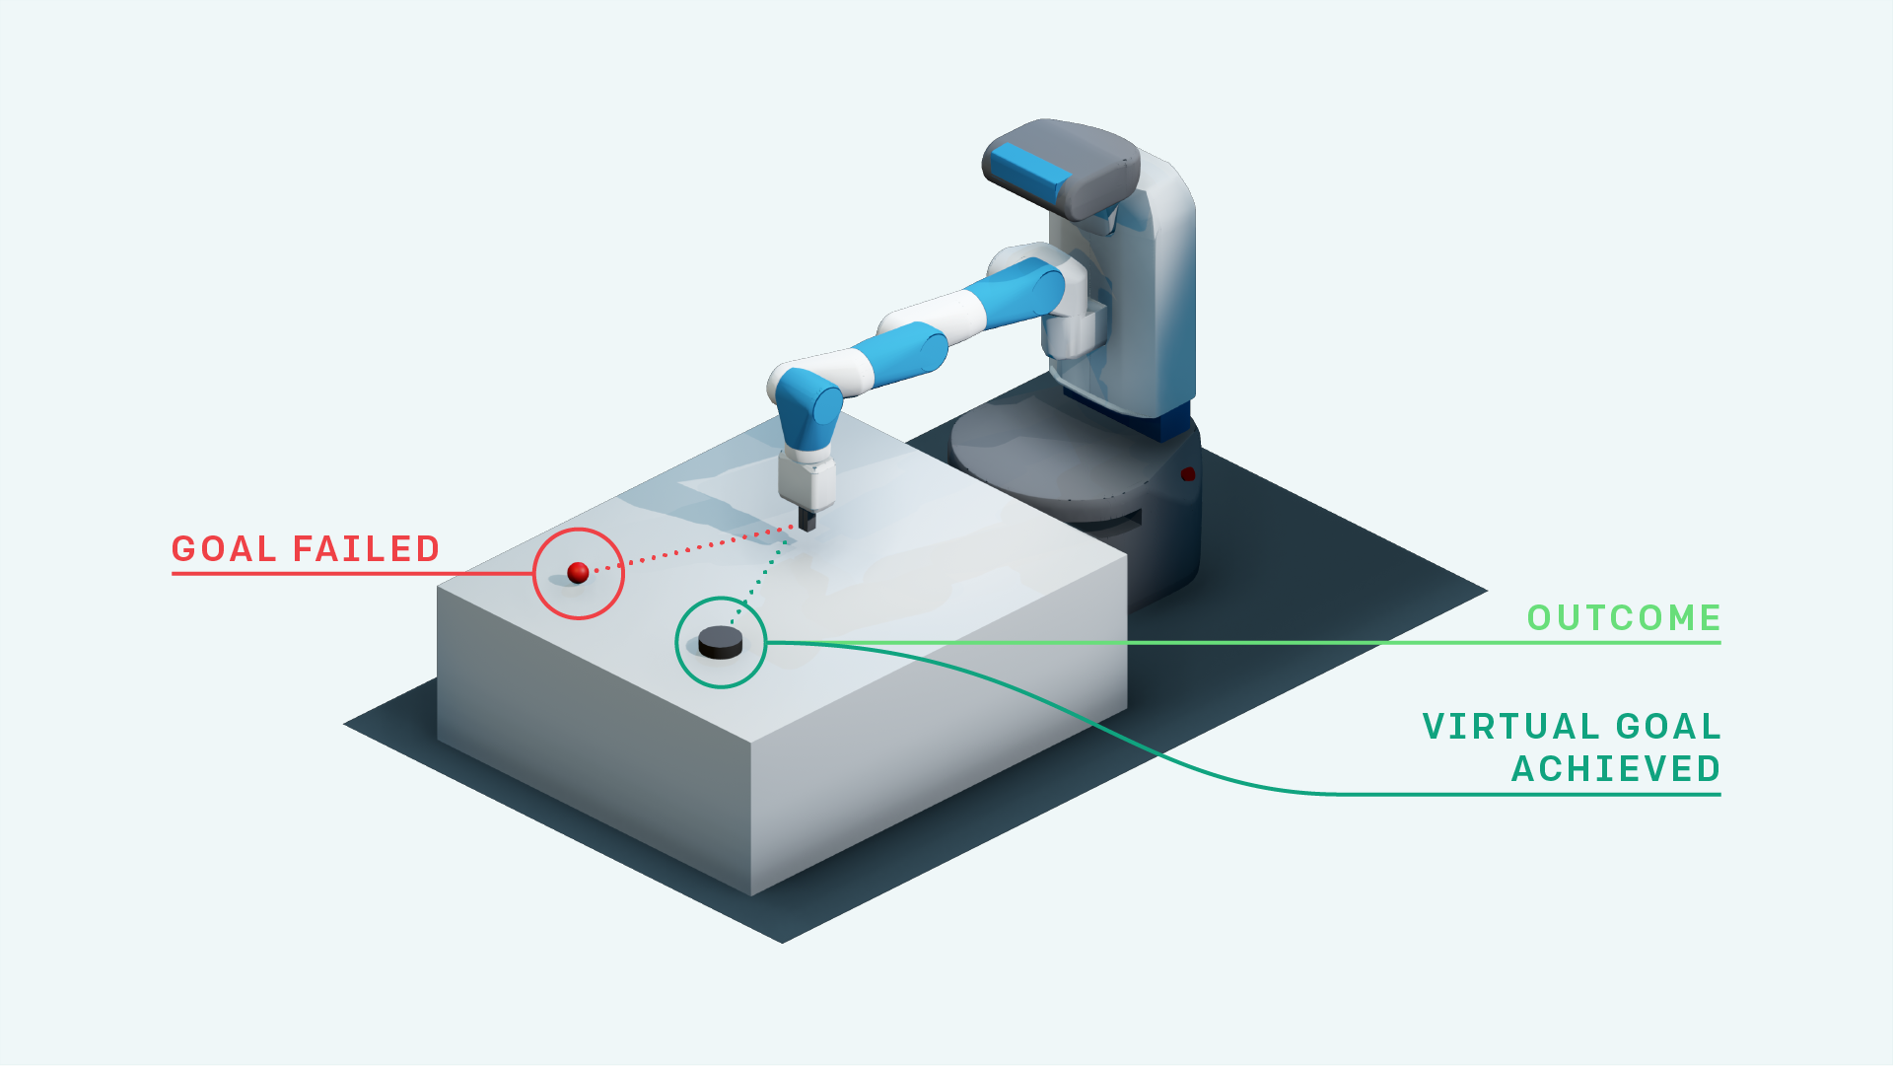
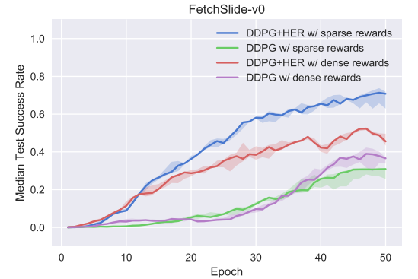
Hindsight Experience Replay (HER)
Sparse and binary rewards (reward engineering?)
Multi-goal
Replay buffer
Fetch Slide
Slippery table with friction
Out of the robot’s reach
Hit the puck to slide
Stop at target position

Slide 7
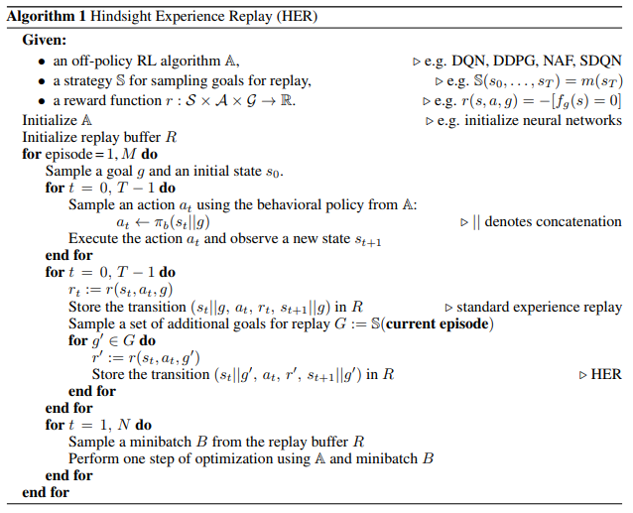
Hindsight Experience Replay (HER)

Slide 8
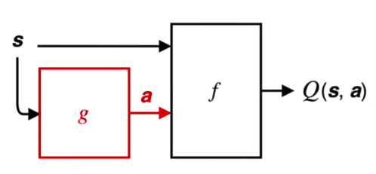
Deep Deterministic Policy Gradients (DDPG)
Model-free RL algorithm for continuous action spaces
Deterministic policy: g
Goal: to find f that maximize expectation
Two neural networks:
target policy (actor)
action-value function approximator (critic)

Slide 9
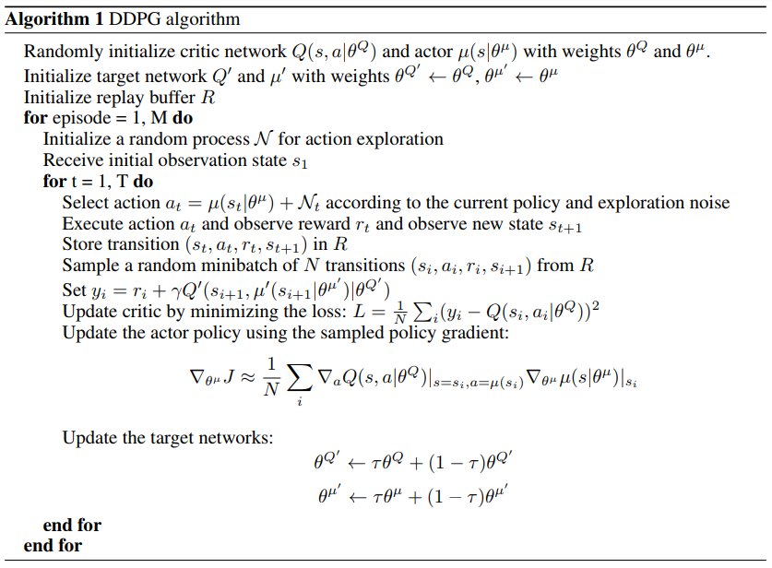
Deep Deterministic Policy Gradients (DDPG)

Slide 10
Thanks for listening!
Table Tennis Juggling using HER & DDPG
Yu Chen, Yuan Zhang

